Slide 1
CPS 109 - Lab 8

Slide 2
Agenda
More on Classes and Tests
Randomness
List Comprehension
Multi-Dimensional Arrays

Slide 3
More on Classes and Tests
What do we remember about classes and tests?

Slide 4
More on Classes and Tests
Recall: a class is your own custom datatype!
An object is a specific instance of that class.

Slide 5
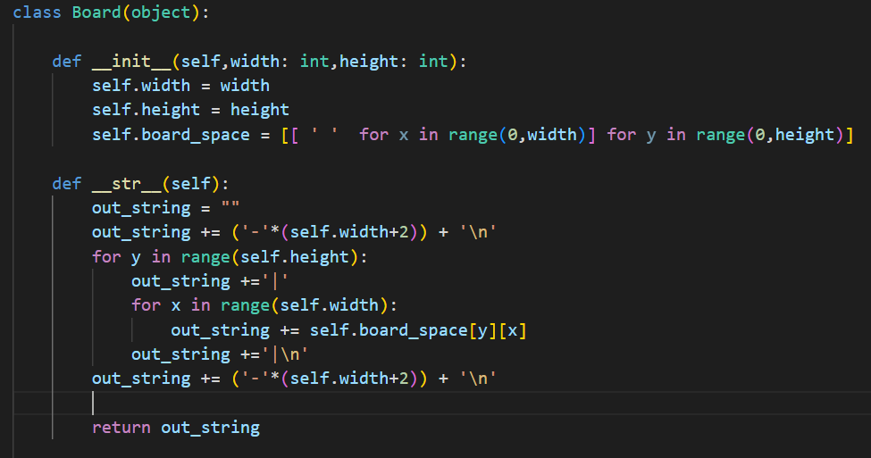
More on Classes

Slide 6
More on Classes and Tests
Recall: Unit Tests are a built in class for the Python UnitTest library! You write your own functions for that class when you want to test code.

Slide 7
Writing (Good) Tests
What makes for a good test? Ask yourself these questions when designing tests:
Does this test check if the function is solving the correct problem?
Does this test cover a case that must be tested?
Is this test testing atomic behaviour?

Slide 8
Blackbox Testing
What is the blackbox? The blackbox shrouds everything inside of it in mystery! You can’t see it.
What is blackbox testing? This is a form of testing that only tests the behaviour of your program. You are making assertions based on behaviour.

Slide 9
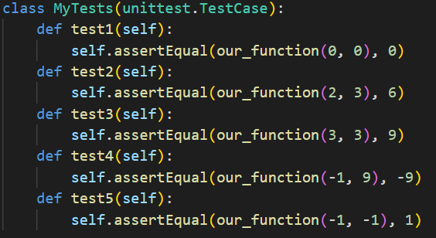
Blackbox Testing

Slide 10
Whitebox Testing
The whitebox allows you to see inside the box, so to speak. It has limited use cases, in which it is only particularly useful when testing, for say, security vulnerabilities.
Blackbox testing is superior.

Slide 11
Randomness
What is randomness? Well, in python, it’s using pseudo randomly generated values or choices to use in your program.

Slide 12
Randomness
Why would you use random numbers or choices?
Several reasons: games of cards, rolling dice, etc.

Slide 13
Multi-Dimensional Arrays
You all have dealt with matrices by now, right?
Multi-dimensional arrays are a way to represent those.

Slide 14
Multi-Dimensional Arrays
And what are those?
They’re just lists within lists.

Slide 15
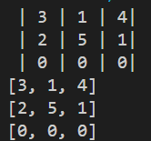
Multi-Dimensional Arrays

Slide 16
List Comprehension
Some of you may have noticed the solution I posted for the tuple sort…
This is quick sort. I am not the first or last person to do list comprehension this way.

Slide 17
List Comprehension
What the heck is that? That syntax is called list comprehension.
List comprehension offers a shorter syntax when you want to create a new list based on the values of an existing list.

Slide 18
List Comprehension
Let’s break down what is happening here.
This creates a list that matches the criteria set out on the right of the if statement.

Slide 19
Questions?

